Slide 1
E-retail factors for customer activation and retention: A case study from Indian e-commerce customers

Slide 2
Overview
Customer satisfaction has emerged as one of the most important factors that guarantee the success of online stores; it has been posited as a key stimulant of purchase, repurchase intentions, and customer loyalty. A comprehensive review of the literature, theories, and models has been carried out to propose the models for customer activation and customer retention.
Five major factors that contributed to the success of an e-commerce store have been identified as service quality, system quality, information quality, trust, and net benefit. The research furthermore investigated the factors that influence online customers to repeat purchase intention. The combination of both utilitarian values and hedonistic values is needed to affect the repeat purchase intention (loyalty) positively. The data is collected from Indian online shoppers. Results indicate the e-retail success factors, which are very much critical for customer satisfaction.

Slide 3
ABOUT DATASET
The dataset contains several columns. Columns describe each and every general information regarding online shopping. Customer behavior regarding online shopping and about different-different shopping applications etc.

Slide 4
Problem statements
In this dataset we need to find out how many people get indulge in online shopping. What is the most indulged gender in online shopping
How to deal the customers who are not involved much in online shopping.

Slide 5
Tools
I have used several EDA (Exploratory Data Analysis in this project) for studying the dataset.
Further, I have used visualization techniques like plotting different graphs for visualizing and better understanding the dataset.

Slide 6
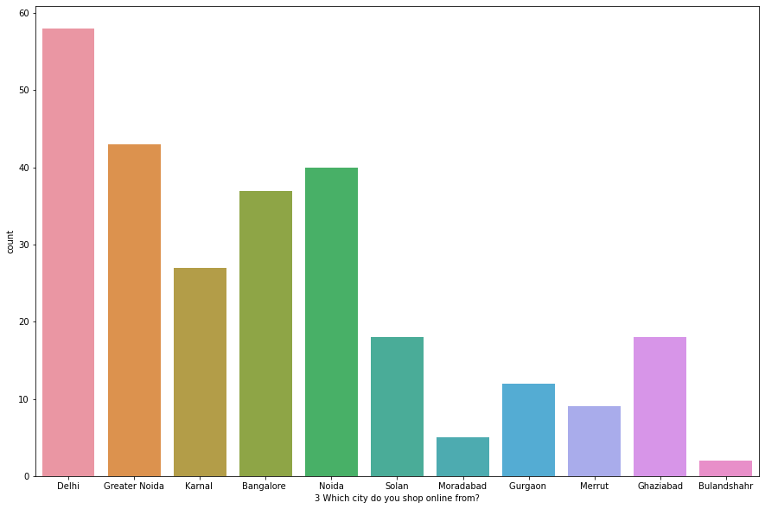
Checking which cities customers prefer more for online shopping
OBSERVATION:- 58% of customers prefer to shop online from Delhi.
43% of customers prefer to shop online from Greater Noida.
40% of customers prefer to shop online from Noida.
37% of customers prefer to shop online from Bangalore.
27% of customers prefer to shop online from Karnal.
18% of customers prefer to shop online from Solan and Ghaziabad each.
12% of customers prefer to shop online from Gurgaon.
9% of customers prefer to shop online from Merrut.
5% of customers prefer to shop online from Moradabad.
By these percentages, we can see that Delhi has the maximum number of customers who prefer to shop online which is 58%.
and Bulandshahr has the least number of customers who prefer to shop online which is 2%.

Slide 7
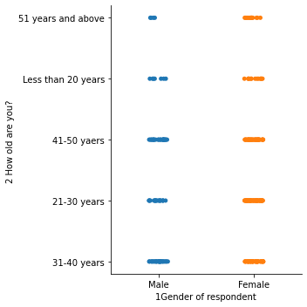
Checking customer’s preferences by comparing their gender and age group
OBSERVATION:- In the age group between (11-20YEARS) Females use more online shopping
In the age group between (21-30YEARS), Females use more online shopping
In the age group between (31-40YEARS), Females use more online shopping
In the age group between (41-50YEARS), Females use more online shopping
In the age group between (51-60YEARS), Females use more online shopping
As you can see Females of every age group use online shopping more in comparison to Males

Slide 8
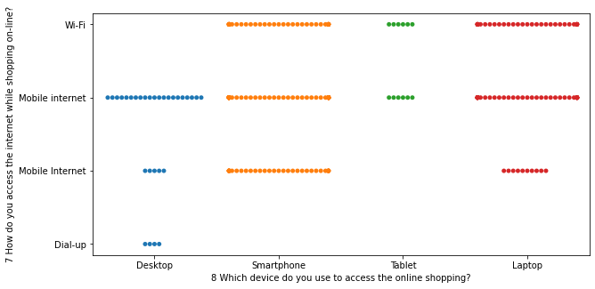
Checking the most preferred device used for doing online shopping and the most preferred internet connection
OBSERVATION: Here it is shown that the most preferred device for doing online shopping is Smartphone and the most preferred
The internet connection is Mobile internet.
Laptops are the second most preferred device and wi-fi is also the second most preferred internet connection.
Desktops are at number 3 and Tablets are at number four.
A Dial-up internet connection is the least used option.

Slide 9
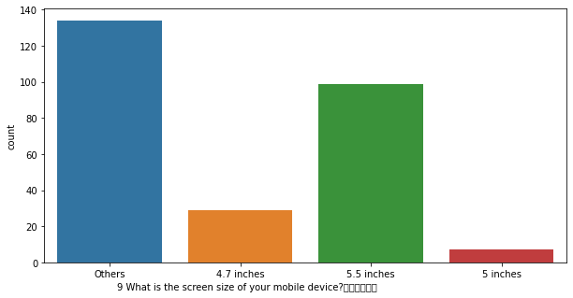
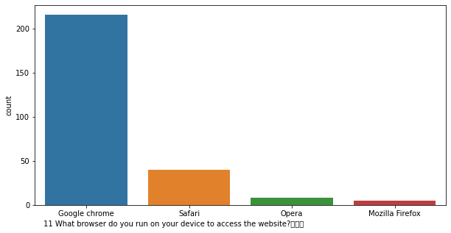
Checking most preferred screen size
Checking the most preferred browser

Slide 10
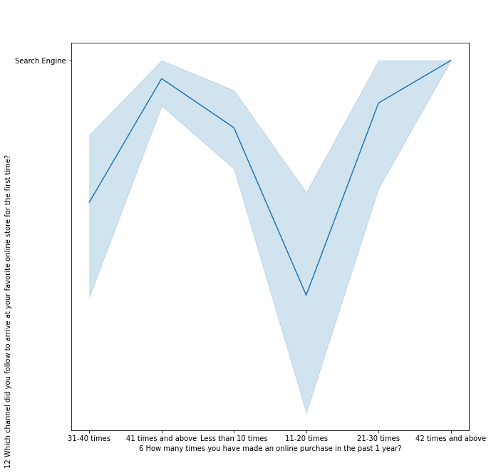
comparing purchases from the past 1 year and preferred channel for online shopping
OBSERVATION:- Customers prefer the Search Engine channel the most for arriving at their favorite online store.
11-20 times is the highest number of purchases that occurred in past year
42 times and above is the least number of purchases that occurred in past year

Slide 11
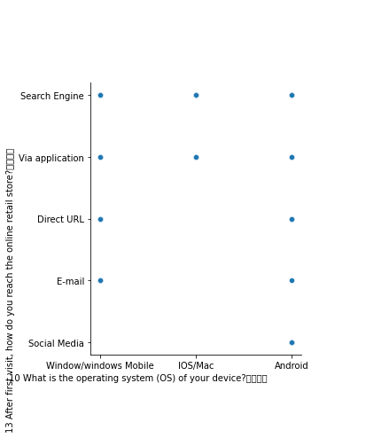
Comparing most preferred operating systems with the most searched channels for online shopping
OBSERVATION:- Android is the most preferred operating system for online shopping and Search Engine is the most searched channel.
Windows Mobile is the second preferred operating system and Via Application is the second searched channel.
IOS/Mac is the third preferred operating system.
Direct URL and E-mail are the third most searched channels.
Social Media is the least searched channel.

Slide 12
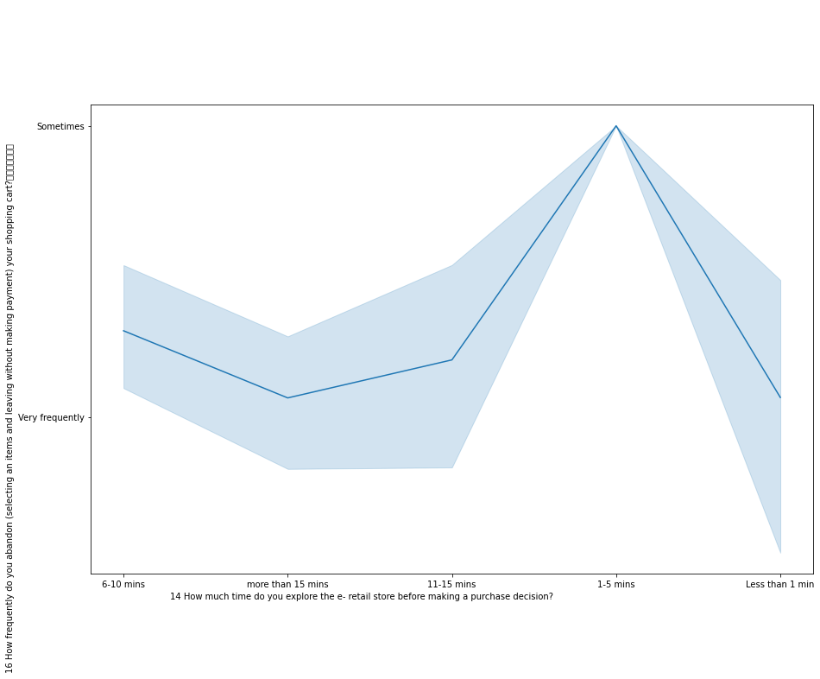
Checking how much time customers explore the e-retail store before making a purchase payment
OBSERVATION:- Around 120% of the customer takes more than 15 mins for exploring the e-retail store before making a purchase decision.
Around 75% of customers take 6-10 mins for exploring e-retail stores before making a purchase decision.
Around 50% of customers take 11-15 mins for exploring the e-retail store before making a purchase decision.
Around 19% of customer take 1-5 mins for exploring e-retail stores before making a purchase decision.
Around 20% costumer take less than 1 mins for exploring e-retail store before making a purchase decision.

Slide 13
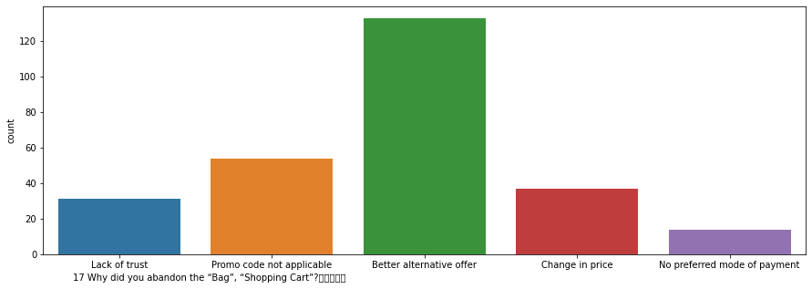
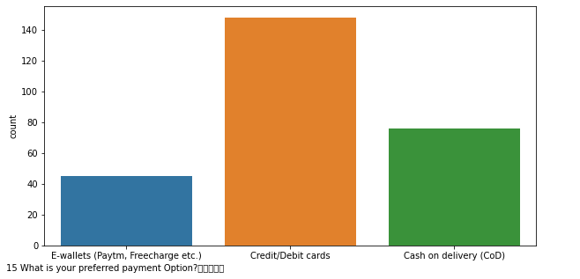
Comparing preferred payment with bagging abandoned
OBSERVATION :- 133% of the customers abondon the shopping cart because they get a better alternative option.
54% of the customers promo code was not applicable.
37% of the customers price change when they were proceeding for payment.
31% of the customers has lack of trust on online shopping.
14% of the customers didn't get their prefered mode of payment.
OBSERVATION :- Cash on Delivery(CoD) is the most prefered payment method with 148% of customer votes.
76% customers prefer Credit/Debit cards for payment.
E-wallets (Paytm,Freecharge.) are the least prefered payment method with only 45% of customer votes.

Slide 14
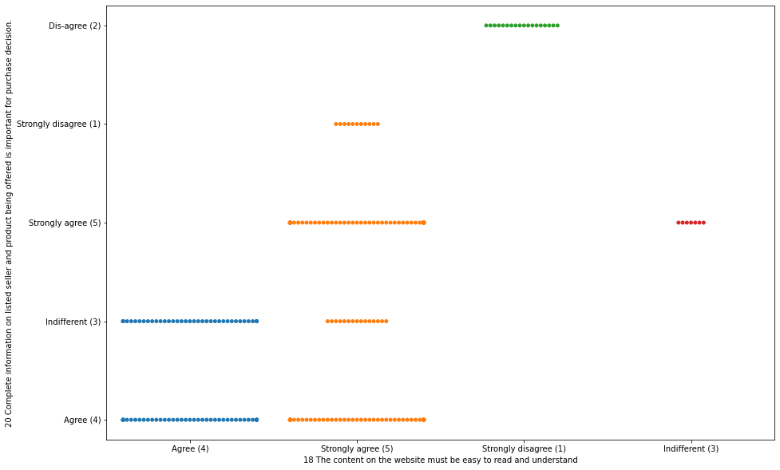
Checking wheather the customers are getting complete information before purchase decision and whether the content on the site is easy to read and understand
OBSERVATION :- Here we can see that the customers are Strongly-agree that the website is easy to read and understand. and they are getting the complete information before purchase decision.

Slide 15
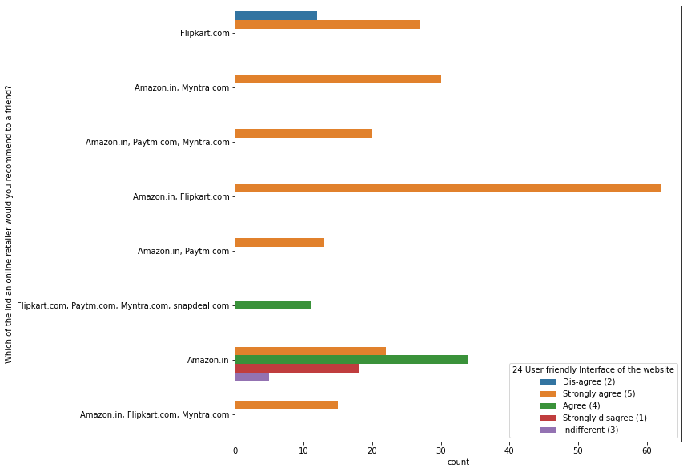
Checking which Indian online retailer site is best to recommend to a friend
OBSERVATION :- Amazon and Flipkart are voted as the best recommended Indian online retailer sites to recommend to a friend.
Myntra gets average votes for recommendation.
Snapdeal and Paytm are the least recommended Indian online retailer sites.

Slide 16
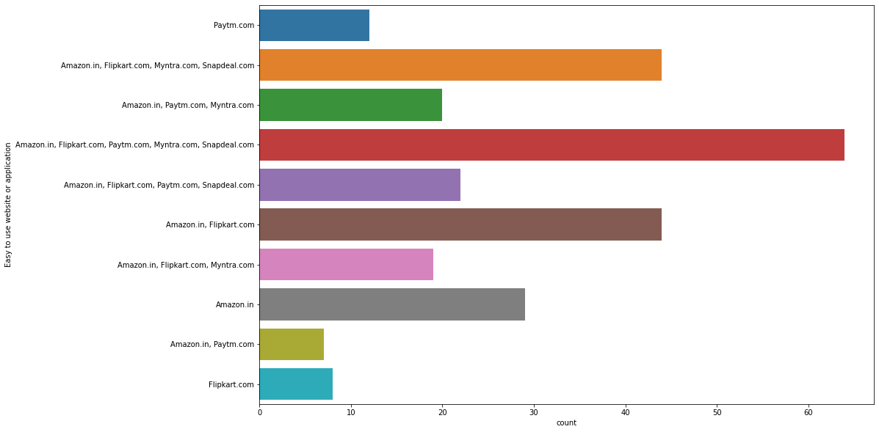
Checking which is the most preferred and easy to use website or application
OBSERVATION :- 64% of the customers prefer Amazon.in, Flipkart.com, Paytm.com, Myntra.com, Snapdeal.com.
44% of the customers prefer Amazon.in, Flipkart.com, Myntra.com, Snapdeal.com.
29% of the customers prefer Amazon.in.
22% of the customers prefer Amazon.in, Flipkart.com, Paytm.com, Snapdeal.com
20% of the customers prefer Amazon.in, Paytm.com, Myntra.com
19% of the customers prefer Amazon.in, Flipkart.com, Myntra.com
12% of the customers prefer Paytm.com
8% of the customers prefer Flipkart.com
7% of the customers prefer Amazon.in, Paytm.com

Slide 17
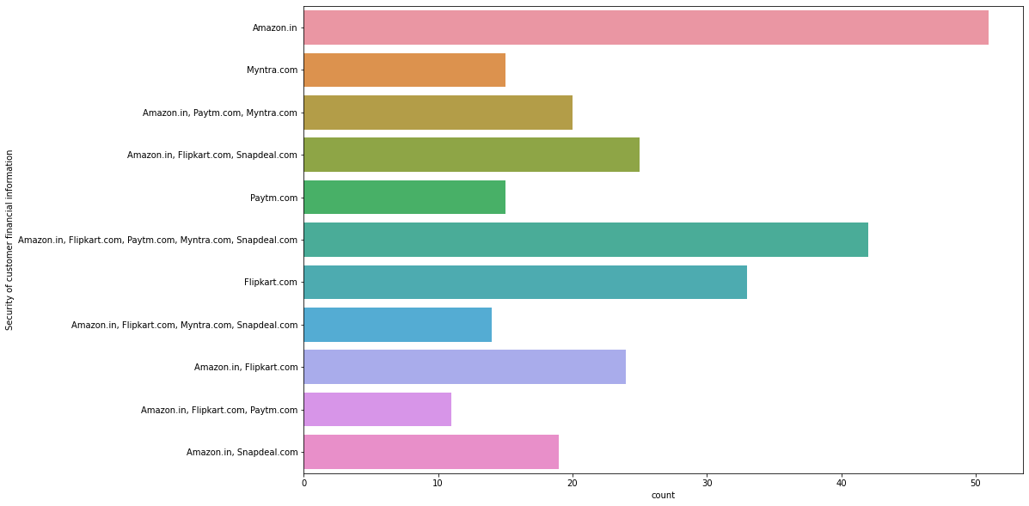
Checking the most preferred app on the basis of Security of customer financial information
OBSERVATION :- 51% of the customers prefer Amazon.in
42% of the customers prefer Amazon.in, Flipkart.com, Paytm.com, Myntra.com, Snapdeal.com
33% of the customers prefer Flipkart.com
25% of the customers prefer Amazon.in, Flipkart.com, Snapdeal.com
24% of the customers prefer Amazon.in, Flipkart.com
20% of the customers prefer Amazon.in, Paytm.com, Myntra.com
19% of the customers prefer Amazon.in, Snapdeal.com
15% of the customers prefer Myntra.com , Paytm.com
14% of the customers prefer Amazon.in, Flipkart.com, Myntra.com, Snapdeal.com
11% of the customers prefer Amazon.in, Flipkart.com, Paytm.com

Slide 18
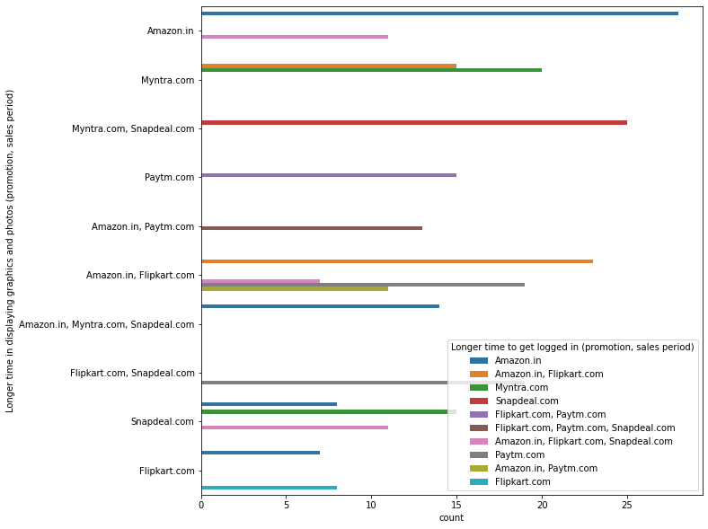
Checking which application take longer time for loading
OBSERVATION :- Amazon takes the Longer time for loading.
Flipkart takes the least time for loading.

Slide 19
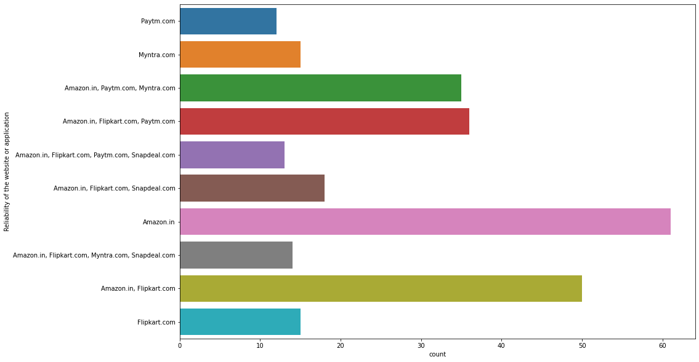
Checking customers preference on the basis of Reliability of the website or application
OBSERVATION :- Amazon is the most prfered application on the basis of reliability gets 60% of the votes.
Flipkart is the least prfered application on the basis of reliability gets 15% of the votes.

Slide 20
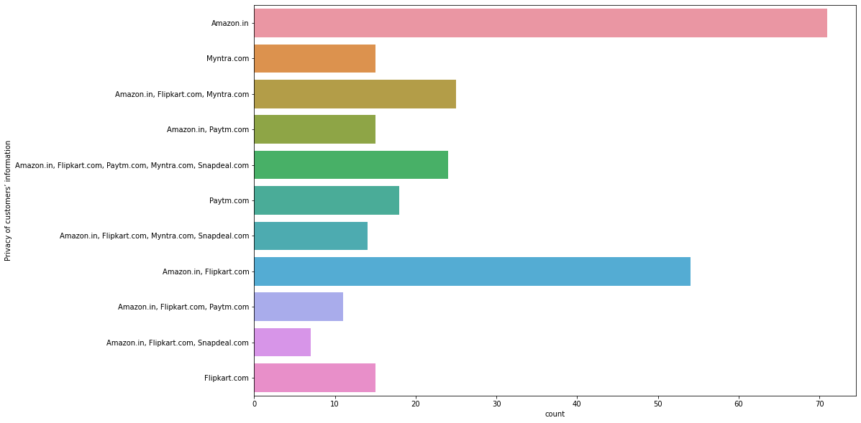
Checking customer preference on the basis of Privacy of customers information
OBSERVATION :- Amazon is the most prfered application on the basis of Privacy of customers information gets 55% of the votes.
Snapdeal is the least prfered application on the basis of Privacy of customers information gets 5% of thevotes.

Slide 21
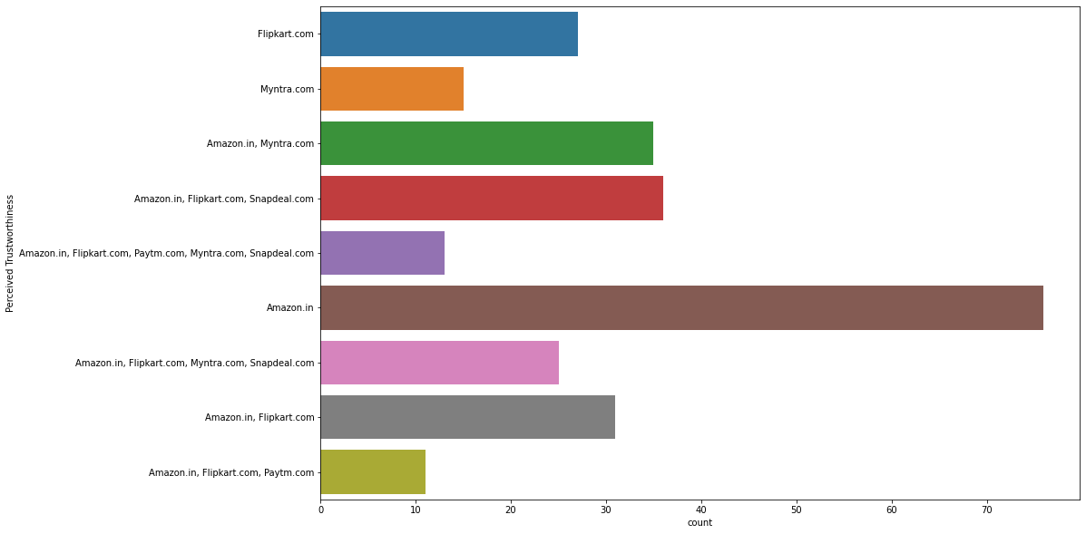
Checking customers preference on the basis of Perceived Trustworthiness
OBSERVATION:- Amazon is the most preferred application on the basis of Perceived Trustworthiness getting 75% of the votes.
Paytm is the least preferred application on the basis of Perceived Trustworthiness getting 10% of the votes.

Slide 22
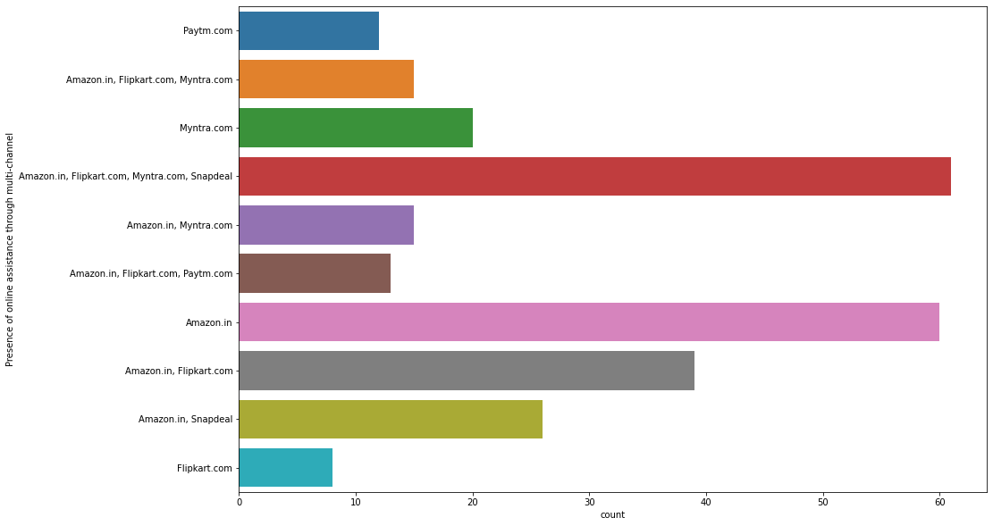
Checking customers preferences on the basis of Presence of online assistance through multi-channel
OBSERVATION :- Amazon is the most prfered application on the basis of Presence of online assistance through multi-channel
gets 60% of the votes.
Flipkart is the least prfered application on the basis of Presence of online assistance through multi-channel gets 5% of the votes.

Slide 23
conclusion
According to the data Female between the age group(31-40) and (21-30) years are the most active customers of online shopping.
Delhi,Greater noida and Noida are the cities where customers prefer online shopping more and Merrut and Moradabad are the cities where online shopping is least preferable. Smartphones are the most prefered device for doing online shopping and Dial-up internet connection is the least prefered device. most of the customers prefer above 5.5 inches as the display size and 5 inches s the least prefered size. Google chrome voted for the most prefered browser gets 210% and Mozilla Firefox geta the least preference which is only 2%. customers use Search Engine the most for arriving to their favorite online store. highest customers puracheses that occured in past one year is (11-20)times and (42)times is the least purchases that occured in past one year. Android is the most prefered operating system for online shopping. after that windows mobile, IOS/Mac , Direct URL and E-mails. Social media is the least most searched oprating channel.Around 120% of customers take more than 15 mins for exploring e-retail store before making a purchase desicion and 20% of the customers use less than 1 min which is the least . 98% of the customers are shopping online from more than 4 years and only 16% of the customers shopping from (1-2)years.
Cash on delivery is the most prefered payment method with 148% of customer votes and E-wallets is the least prefered method with only 45% of customers votes. the most common reason for abondon the shopping cart is that the customers finds a better alternative option. and the least reason for this is the customers didn't get their prefered mode of payment. Amazon and Flipkart are voted as the best recommended Indian online retailer sites to recommend to a friend. and Snapdeal and Paytm are the least. 51% of customers prefer amazon and 11% of the customers prefer paytm on the basic of security of customer financial information. on the basis of reliability Amazon is prefered by 60% of the customers which is the highest and Flipkart only gets 15% of votes. Amazon gets 75% votes and Paytm gets only 10% of votes on the basis of perceived Trustworthiness.

